Slide 1
Global Economic Shifts ECON-220
Gains and Losses from Trade in the Specific-Factors Model
Instructor: Muhebullah Karimzada
Notes:
If this PowerPoint presentation contains mathematical equations, you may need to check that your computer has the following installed:
1) MathType Plugin
2) Math Player (free versions available)
3) NVDA Reader (free versions available)

Slide 2
Questions to Consider
Do you personally gain from inexpensive imported goods?
Besides you, who gains and who loses from trade?
What government policies can help firms and workers that lose from trade?

Slide 3
Introduction
The argument from the Ricardian model that trade generates gains for all workers is too simple because labor is the only factor of production in that model.
We relax that assumption with the specific-factors model, where land can be used only in the agriculture sector and capital can be used only in the manufacturing sector; labor is used in both sectors.
From the Ricardian model, we learned that free trade affects relative prices, and this in turn affects the earnings of factors of production.
The question addressed by the specific-factors model is how trade, through changes in relative prices, affects the earnings of labor, land, and capital.

Slide 4
1) Specific-Factors Model (part 1)
The specific-factors model we will develop has the following features:
Once again there are two countries: Home and Foreign.
Manufacturing uses labor and capital, and agriculture uses labor and land.
In each industry, increases in the amount of labor used are subject to diminishing returns; that is, the marginal product of labor declines as the amount of labor used in the industry increases.
For now let’s focus on the Home country.

Slide 5
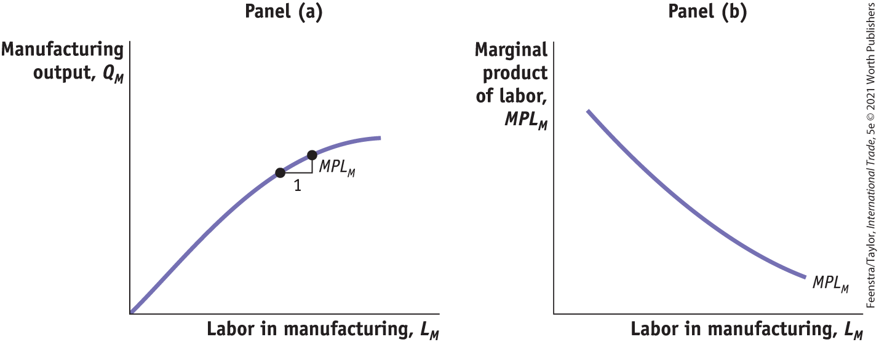
1) Specific-Factors Model (part 2)
The Home Country
FIGURE 3-1
Panel (a) Manufacturing Output As more labor is used, manufacturing output increases, but it does so at a diminishing rate.
Panel (b) Diminishing Marginal Product of Labor An increase in the amount of labor used in manufacturing lowers the marginal product of labor.

Slide 6
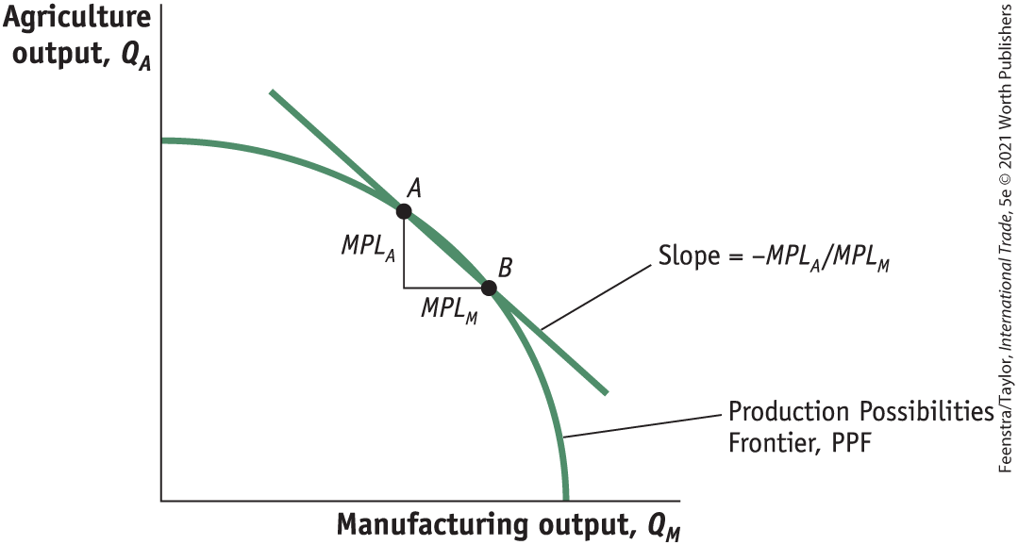
1) Specific-Factors Model (part 3)
The Home Country
Production Possibilities Frontier
FIGURE 3-2
Production Possibilities Frontier
The production possibilities frontier shows the amount of agricultural and manufacturing outputs that can be produced in the economy with labor.

Slide 7

1) Specific-Factors Model (part 4)
The Home Country
Opportunity Cost and Prices
As in the Ricardian model, the slope of the PPF equals the opportunity cost or relative price of the good on the horizontal axis; here it is manufacturing.
Firms hire labor up to the point where the cost of one more hour of labor (the wage) equals the value of one more hour of labor in production.
$$W=P_{M} ∙ {MPL}_{M}$$
$$W=P_{A} ∙ {MPL}_{A}$$

Slide 8
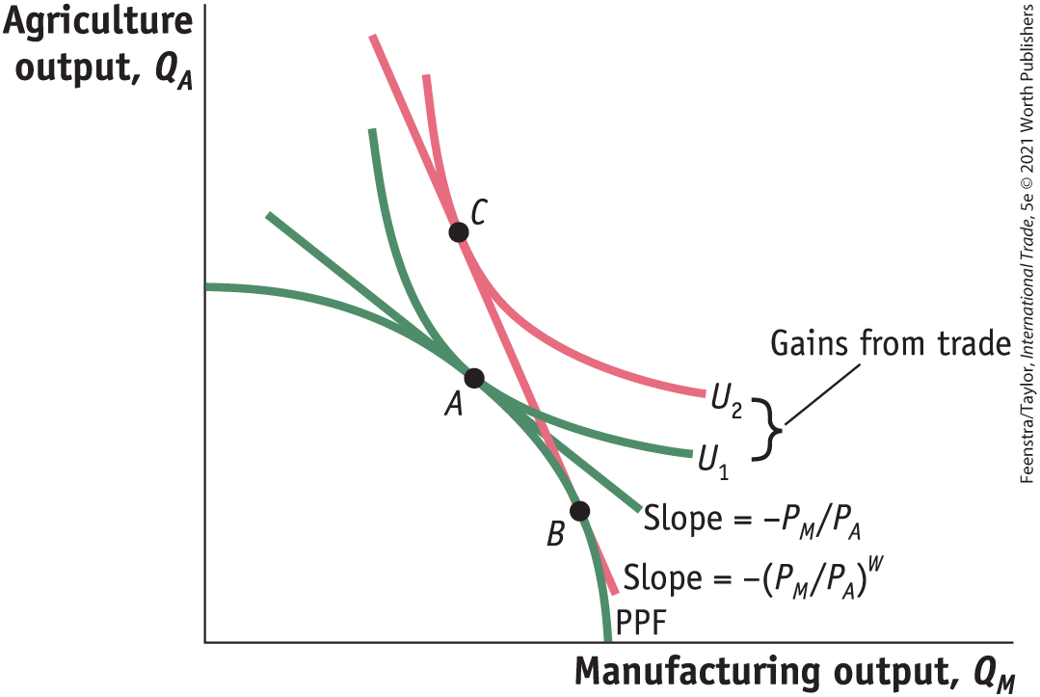
1) Specific-Factors Model (part 5)
The Home Country
Opportunity Cost and Prices
FIGURE 3-3
In the absence of international trade, the economy produces and consumes at point A.
The relative price of manufactures, P_{M}/P_{A}, is the slope of the line tangent to the PPF and indifference curve U₁, at point A.
With international trade, the economy is able to produce at point B and consume at point C.
The world relative price of manufactures, (P_{M}/P_{A})^{W}, is the slope of the line BC.
The rise in utility from U₁ to U₂ is a measure of the gains from trade for the economy.

Slide 9
1) Specific-Factors Model (part 6)
The Foreign Country
Let us assume that the Home no-trade relative price of manufacturing is lower than the Foreign relative price.
$$\left({P_{M}}/{P_{A}}\right)< \left({P_{ M}^{∗}}/{P_{ A}^{∗}}\right)$$
This means that Home can produce manufactured goods relatively cheaper than Foreign.
Put another way, Home has a comparative advantage in manufacturing.

Slide 10
1) Specific-Factors Model (part 7)
Overall Gains from Trade
The good whose relative price goes up (manufacturing, for Home) is exported.
The good whose relative price goes down (agriculture, for Home) is imported.
By exporting manufactured goods at a higher price and importing food at a lower price, Home is better off than it was in the absence of trade.

Slide 11
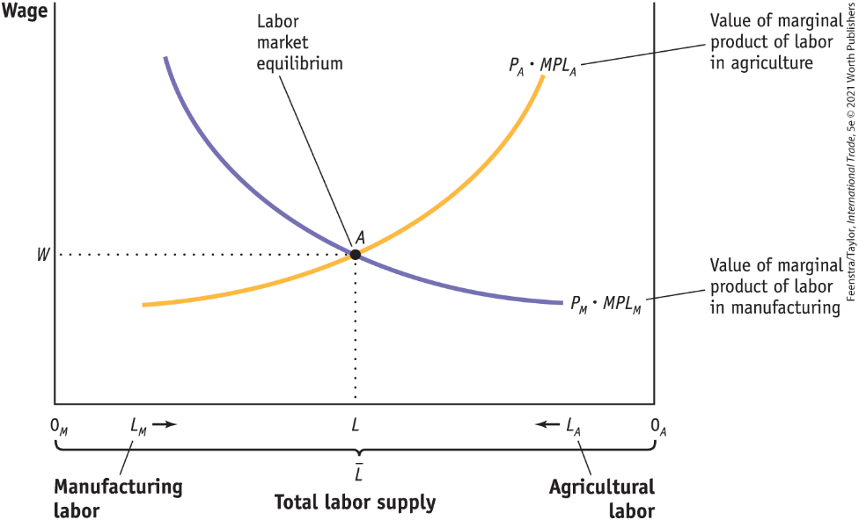
2) Earnings of Labor (part 1)
Determination of Wages
FIGURE 3-4 (1 of 2)
The amount of labor used in manufacturing is measured from left to right along the horizontal axis, and the amount of labor used in agriculture is measured from right to left.

Slide 12
2) Earnings of Labor (part 2)
Determination of Wages
FIGURE 3-4 (2 of 2)
Labor market equilibrium is at point A. At the equilibrium wage of W, manufacturing uses 0_{M}L units of labor and agriculture uses 0_{A}L units.

Slide 13
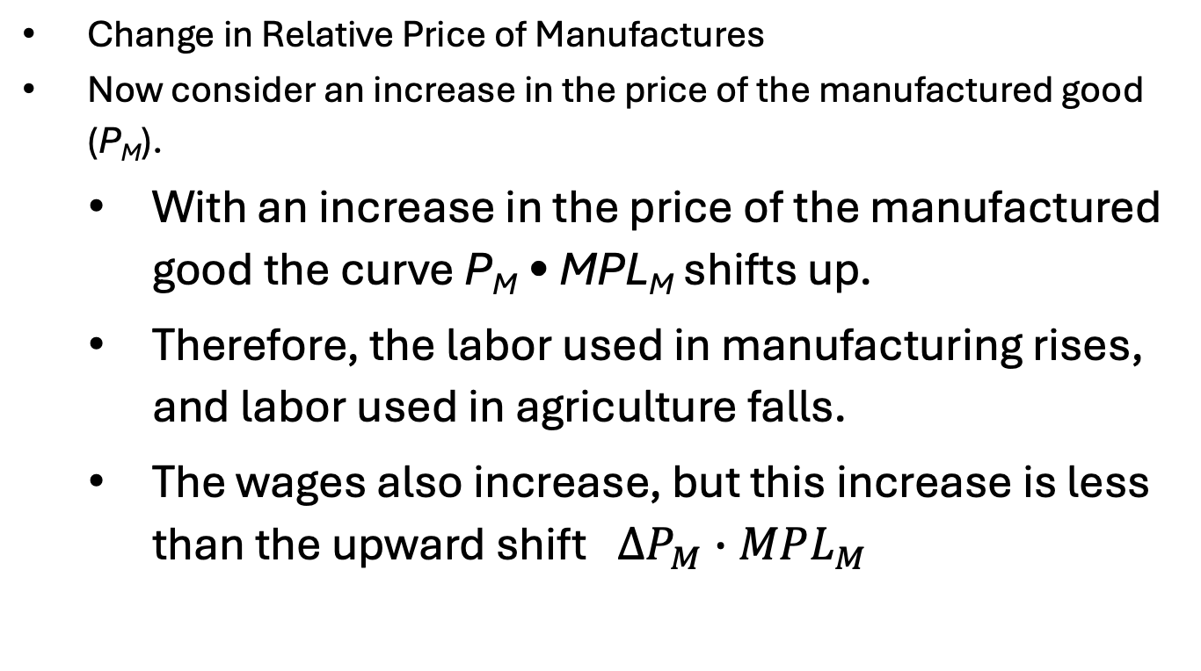
2) Earnings of Labor (part 3)
Change in Relative Price of Manufactures
Now consider an increase in the price of the manufactured good (P_{M}).
With an increase in the price of the manufactured good the curve P_{M} • MPL_{M} shifts up.
Therefore, the labor used in manufacturing rises, and labor used in agriculture falls.
The wages also increase, but this increase is less than the upward shift ${ ∆P}_{M} ∙MPL_{M}$

Slide 14
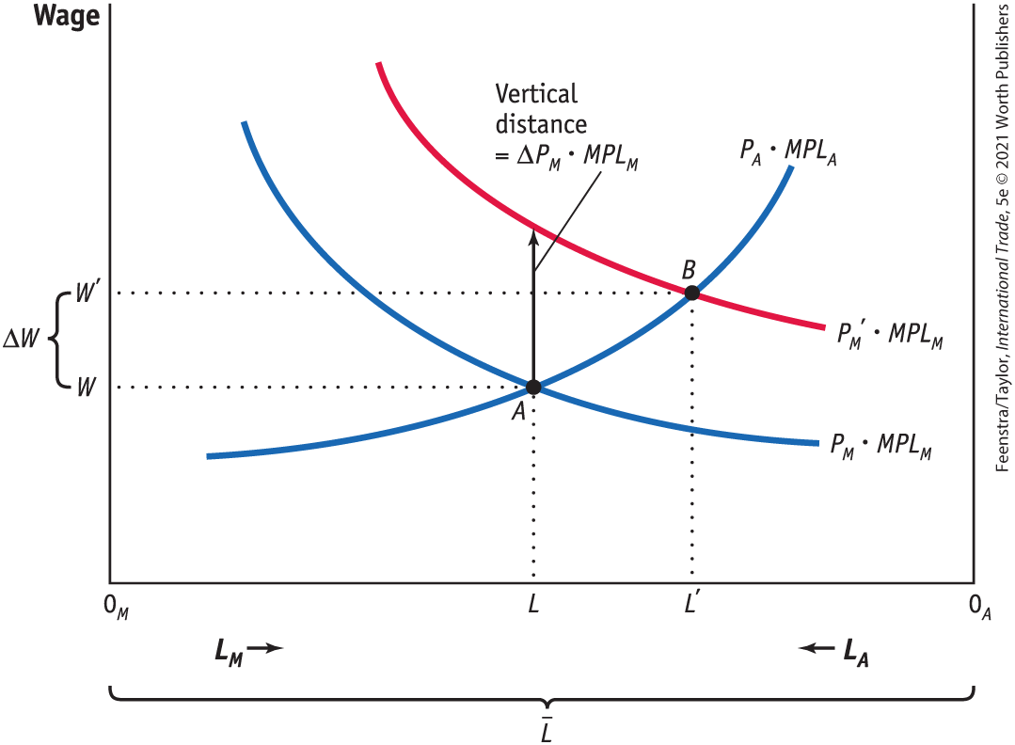
2) Earnings of Labor (part 4)
Change in Relative Price of Manufactures
FIGURE 3-5
Increase in the Price of Manufactured Goods
With an increase in the price of the manufactured good, the curve P_{M} • MPL_{M} shifts up to P_{M}′ • MPL_{M} and the equilibrium shifts from point A to B.
The labor used in manufacturing rises from 0_{M}L to 0_{M}L′, and labor used in agriculture falls from 0_{A}L to 0_{A}L′.
The wage increases from W to W′, but this increase is less than the upward shift ΔP_{M} • MPL_{M}.

Slide 15
2) Earnings of Labor (part 5)
Change in Relative Price of Manufactures
Effect on Real Wages
As we can see from Figure 3-5, the increase in the wage from W to W′ is less than the vertical increase ΔP_{M} • MPL_{M}
Since ΔW/W < ΔP_{M} /P_{M} , the percentage increase in the wage is less than the percentage increase in the price of the manufactured good.
This inequality means that the amount of the manufactured good that can be purchased with the wage has fallen.
Therefore, the real wage in terms of the manufactured good W/P_{M} has decreased.

Slide 16
2) Earnings of Labor (part 6)
Change in Relative Price of Manufactures
Effect on Real Wages
Once again, since ΔW/W < ΔP_{M} /P_{M}, the percentage increase in the wage is less than the percentage increase in the price of the manufactured good.
The manufactured good that can be purchased with the wage has fallen.
Therefore, the real wage in terms of the manufactured good W/PM has decreased.
FIGURE 3-5

Slide 17
2) Earnings of Labor (part 7)
Change in Relative Price of Manufactures
Overall Impact on Labor
In the specific-factors model, the increase in the price of the manufactured good has an ambiguous effect on the real wage and therefore an ambiguous effect on the well-being of workers. Although ambiguous, this conclusion is important.
The result is different from what was found in the Ricardian model, where labor unambiguously earned a higher real wage.
This warns us that one cannot make unqualified statements about the effects of trade on workers.
The effect of trade on real wages can be complex.

Slide 18
2) Earnings of Labor (part 8)
Change in Relative Price of Manufactures
Unemployment in the Specific-Factors Model
It is hard to combine business cycle models with international trade models to isolate the effects of trade on workers.
Once we recognize that workers can find new jobs—possibly in export industries that are expanding—we still cannot conclude that trade is necessarily good or bad for workers.
Next we look at some evidence from the United States on the amount of time it takes to find new jobs and on the wages earned; we also look at attempts by governments to compensate workers who lose their jobs because of import competition. This type of compensation is called Trade Adjustment Assistance (TAA) in the United States.

Slide 19
3) Earnings of Capital and Land (part 1)
Determining the Payments to Capital and Land
If Q_{M} is the output in manufacturing and Q_{A} is the output in agriculture, the revenue earned in each industry is P_{M} • Q_{M} and P_{A} • Q_{A}, and the payments to capital and to land are:
$Payment to capital=P_{M}∙Q_{M}−W∙L_{M}$
$$Payments to land=P_{A}∙Q_{A}−W∙L_{A}$$

Slide 20


3) Earnings of Capital and Land (part 2)
Determining the Payments to Capital and Land
The earnings of one unit of capital (a machine, for instance), which we call R_{K}, and the earnings of an acre of land, which we call R_{T}, are calculated as:
$$R_{K}= \frac{Payments to capital}{K}=\frac{P_{M}∙Q_{M}−W∙L_{M}}{K}$$
$$R_{T}=\frac{Payments to land}{T}=\frac{P_{A}∙Q_{A}−W∙L_{A}}{T}$$
Economists call R_{K} the rental on capital and R_{T} the rental on land.

Slide 21
3) Earnings of Capital and Land (part 3)
Determining the Payments to Capital and Land
Change in the Real Rental on Capital
As more labor is used in manufacturing, the marginal product of capital will rise because each machine has more labor to work it.
In addition, as labor leaves agriculture, the marginal product of land will fall because each acre of land has fewer laborers to work it.
The general conclusion is that an increase in the quantity of labor used in an industry will raise the marginal product of the factor specific to that industry, and a decrease in labor will lower the marginal product of the specific factor.

Slide 22
3) Earnings of Capital and Land (part 4)
Determining the Payments to Capital and Land
With labor leaving agriculture, the marginal product of each acre falls, so R_{T} /P_{A} also falls.
The fact that R_{T} /P_{A} falls means that the real rental on land in terms of food has gone down, so landowners cannot afford to buy as much food.
Thus, landowners are clearly worse off from the rise in the price of the manufactured good because they can afford to buy less of both goods.

Slide 23
3) Earnings of Capital and Land (part 5)
Determining the Payments to Capital and Land
Summary
An increase in the relative price of an industry’s output will increase the real rental earned by the factor specific to that industry but will decrease the real rental of factors specific to other industries.
This conclusion means that:
The specific factors used in export industries will generally gain as trade is opened.
The relative price of exports rises.
The specific factors used in import industries will generally lose as trade is opened and the relative price of imports falls.

Slide 24
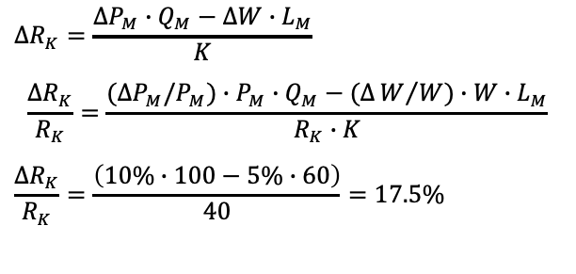
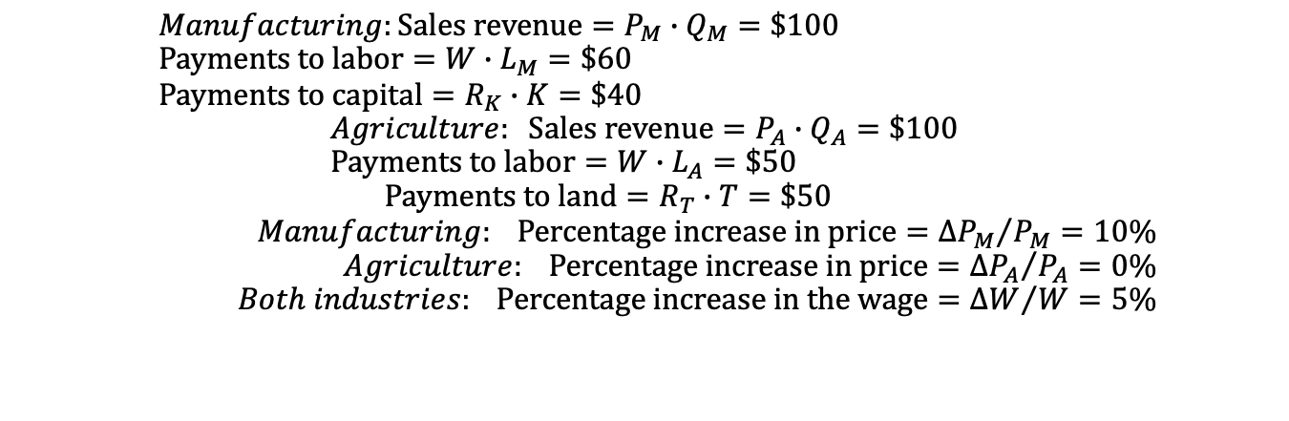
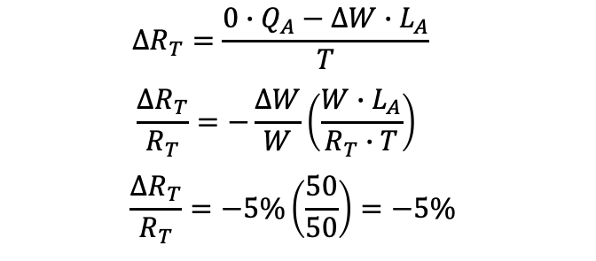
3) Earnings of Capital and Land (part 6)
$$Manufacturing:Sales revenue=P_{M}∙Q_{M}=\$100 \\ Payments to labor=W∙L_{M}=\$60 \\ Payments to capital=R_{K}∙K=\$40$$
$$Agriculture: Sales revenue=P_{A}∙Q_{A}=\$100 \\ Payments to labor=W∙L_{A}=\$50$$
$$Payments to land=R_{T}∙T=\$50$$
$$Manufacturing: Percentage increase in price={∆P_{M}}/{P_{M}=10\%} \\ Agriculture: Percentage increase in price={∆P_{A}}/{P_{A}=0\%} \\ Both industries: Percentage increase in the wage={∆W}/{W=5\%}$$
Change in the Rental on Capital
Change in the Rental on Land
$$∆R_{K}=\frac{∆P_{M}∙Q_{M}−∆W∙L_{M}}{K}$$
$$\frac{∆R_{K}}{R_{K}}=\frac{(∆P_{M}/P_{M})∙P_{M}∙Q_{M}−(∆W/W)∙W∙L_{M}}{R_{K}∙K}$$
$$\frac{∆R_{K}}{R_{K}}=\frac{\left(10\%∙100−5\%∙60\right)}{40}=17.5\%$$
$$∆R_{T}=\frac{0∙Q_{A}−∆W∙L_{A}}{T}$$
$$\frac{∆R_{T}}{R_{T}}=−\frac{∆W}{W}\left(\frac{W∙L_{A}}{R_{T}∙T}\right)$$
$$\frac{∆R_{T}}{R_{T}}=−5\%\left(\frac{50}{50}\right)=−5\%$$

Slide 25



3) Earnings of Capital and Land (part 7)
General Equation for the Change in Factor Prices
These equations summarize the response of all three factor prices in the short run, when capital and land are specific to each sector but labor is mobile.
$\underset{\begin{aligned} \\ Real rental \\ on land falls\end{aligned}}{\underbrace{∆R_{T}/R_{T}<0}}$ $\underset{\begin{aligned} \\ Change in the real \\ wage is ambiguous\end{aligned}}{\underbrace{<{∆W}/{W<∆P_{M}/}}}\underset{\begin{aligned} \\ Real rental \\ on capital rises\end{aligned}}{\underbrace{P_{M}<∆{R_{K}}/{R_{K}}}}$, for an increase in $P_{M}$
$\underset{\begin{aligned} \\ Real rental \\ on capital falls\end{aligned}}{\underbrace{∆R_{K}/R_{K}<∆P_{M}}}$/$\underset{\begin{aligned} \\ Change in the real \\ wage is ambiguous\end{aligned}}{\underbrace{P_{M}<∆W/{W<0}}} \underset{\begin{aligned} \\ Real rental \\ on land rises\end{aligned}}{\underbrace{<∆{R_{T}}/{R_{T}}}},$ for a decrease in $P_{M}$
$\underset{\begin{aligned} \\ Real rental \\ on capital falls\end{aligned}}{\underbrace{∆R_{K}/R_{K}<0}}\underset{\begin{aligned} \\ Change in the real \\ wage is ambiguous\end{aligned}}{\underbrace{<∆W/{W<∆P_{A}/}}}$ $\underset{\begin{aligned} \\ Real rental \\ on land rises\end{aligned}}{\underbrace{P_{A}<∆{R_{T}}/{R_{T,}}}}$ for an increase in $P_{A}$

Slide 26
Conclusions (part 1)
As long as the relative price with international trade differs from the no-trade relative price, a country will gain from international trade.
The change in relative prices due to the opening of trade creates winners and losers. Some factors of production gain in real terms, and other factors of production lose.
The factor that is specific to the importing-competing industry will lose. That industry suffers a drop in its relative price due to international trade, which leads to a fall in the real rental on the specific factor in that industry.
The specific factor in the export industry, whose relative price rises with the opening of trade, enjoys an increase in real rental.

Slide 27
Conclusions (part 2)
Labor is mobile between the two industries, which allows it to avoid such extreme changes in wages. Real wages rise in terms of one good but fall in terms of the other good, so we cannot tell whether workers are better off or worse off after a country opens to trade.
In theory, the gains of individuals as a result of the opening of trade exceed the losses. That means, in principle, that the government could tax the winners and compensate the losers in such a way that everyone would be better off. This has proven to be very challenging in practice.

